Slide 1
FINANCIAL AID
AT NC STATE
NC STATE UNIVERSITY
STUDENT SERVICES CENTER – OFFICE OF SCHOLARSHIPS AND FINANCIAL AID
STUDENTSERVICES.NCSU.EDU
UPDATES ACADEMICS CAREERS FINANCES COMMENCEMENT RESOURCES

Slide 2
APPLYING FOR FINANCIAL AID
Free Application for Federal Student Aid (FAFSA ®)
Visit studentaid.gov to start application
FREE application; complete annually
Required for federal, state, and institutional need-based aid
2025-26 Application available December 2024
Priority filing date: March 1st
NCSU School Code: 002972
NC STATE UNIVERSITY
STUDENT SERVICES CENTER – OFFICE OF SCHOLARSHIPS AND FINANCIAL AID
STUDENTSERVICES.NCSU.EDU

Slide 3
WHAT IS THE STUDENT AID INDEX (SAI)?
SAI Determination
Calculation determined after completing FAFSA
Measurement of family’s financial strength
Used to determine financial aid eligibility
Does not reflect amount family/student will have to pay
NC STATE UNIVERSITY
STUDENT SERVICES CENTER – OFFICE OF SCHOLARSHIPS AND FINANCIAL AID
STUDENTSERVICES.NCSU.EDU

Slide 4
WHAT IS THE COST OF ATTENDANCE (COA)?
Reflect expenses related to student’s higher education
Includes both direct and indirect expenses
Expenses include:
Tuition and Fees
Housing and Food
Books and Supplies
Personal Expenses
Transportation
Loan Fees
NC STATE UNIVERSITY
STUDENT SERVICES CENTER – OFFICE OF SCHOLARSHIPS AND FINANCIAL AID
STUDENTSERVICES.NCSU.EDU

Slide 5
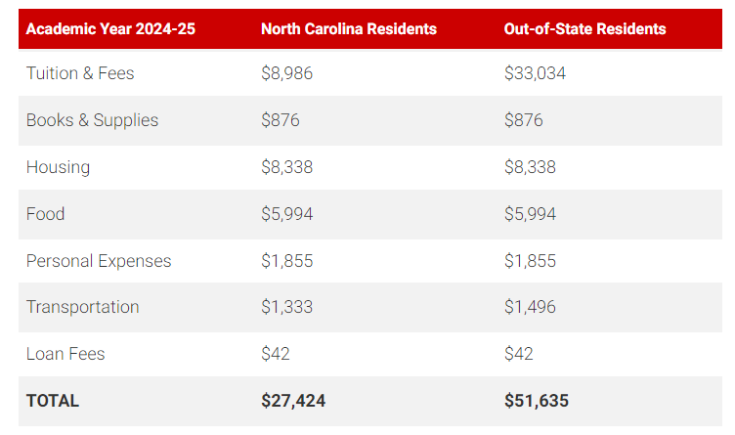
WHAT IS THE UNDERGRADUATE STUDENT ESTIMATED COA?
NC STATE UNIVERSITY
STUDENT SERVICES CENTER – OFFICE OF SCHOLARSHIPS AND FINANCIAL AID
STUDENTSERVICES.NCSU.EDU

Slide 6
HOW IS FINANCIAL NEED DETERMINED?
Cost of Attendance
(COA)
Student Aid Index (SAI)
Financial Need
Example:
$25,000 (COA) - $10,000 (SAI) = $15,000 (Financial Need)
NC STATE UNIVERSITY
STUDENT SERVICES CENTER – OFFICE OF SCHOLARSHIPS AND FINANCIAL AID
STUDENTSERVICES.NCSU.EDU

Slide 7
WHAT ARE THE TYPES OF FINANCIAL AID?
Scholarships
Grants
Student Employment
Loans
NC STATE UNIVERSITY
STUDENT SERVICES CENTER – OFFICE OF SCHOLARSHIPS AND FINANCIAL AID
STUDENTSERVICES.NCSU.EDU

Slide 8
WHAT ARE THE TYPES OF FINANCIAL AID?
Scholarships
Grants
Merit-based and/or need based funding: FREE support
Awarded by the university or private organizations/individuals
May or may not be renewable
Need-based funding: FREE support
Awarded by Federal and State governments, the university, or private organizations/individuals
Student Employment
Loans
Money that you EARN
On-campus employment
Flexible work schedule
Money that you BORROW
Must be repaid
Federal or private loan options
NC STATE UNIVERSITY
STUDENT SERVICES CENTER – OFFICE OF SCHOLARSHIPS AND FINANCIAL AID
STUDENTSERVICES.NCSU.EDU

Slide 9
HOW TO APPLY FOR FINANCIAL AID?
Change of Circumstances?
Notify School’s Financial Aid Office
Create Your
FSA ID
studentaid.gov
Complete Your FAFSA
by the March 1 deadline
Get Your
FAFSA Submission Summary
OSFA Sends Initial Aid Offers early April
Selected For Verification
OSFA will be in touch
Submit Additional Required Documents
NC STATE UNIVERSITY
STUDENT SERVICES CENTER – OFFICE OF SCHOLARSHIPS AND FINANCIAL AID
STUDENTSERVICES.NCSU.EDU

Slide 10
SCHOLARSHIPS
AT NC STATE
NC STATE UNIVERSITY
STUDENT SERVICES CENTER – OFFICE OF SCHOLARSHIPS AND FINANCIAL AID
STUDENTSERVICES.NCSU.EDU
UPDATES ACADEMICS CAREERS FINANCES COMMENCEMENT RESOURCES

Slide 11
WHEN TO APPLY FOR SCHOLARSHIPS AT NC STATE?
Before Admission
After Admission
Scholarship Programs of Distinction
Must apply for admission by early action date, November 1
Separate application required
Park.ncsu.edu
Goodnight.ncsu.edu
Textiles.ncsu.edu
University-Wide and College-Based Scholarships
PackASSIST
General Application
College-Based Scholarships Application (Supplemental)
University-Wide and College-Based Scholarships
PackASSIST
General Application
College-Based Scholarships Application (Supplemental)
After The First Semester
Caldwell
Separate application required
Caldwellfellows.ncsu.edu
NC STATE UNIVERSITY
STUDENT SERVICES CENTER – OFFICE OF SCHOLARSHIPS AND FINANCIAL AID
STUDENTSERVICES.NCSU.EDU

Slide 12
WHAT IS NC STATE’S SCHOLARSHIP APPLICATION PORTAL?
PACK ASSIST
A Student Scholarship Interactive Search Tool
Apply upon admission to NC State
General Application opens December 1
Priority Filing Date is February 15
New student award notifications issued by April 1
NC STATE UNIVERSITY
STUDENT SERVICES CENTER – OFFICE OF SCHOLARSHIPS AND FINANCIAL AID
STUDENTSERVICES.NCSU.EDU

Slide 13
WHERE TO APPLY FOR EXTERNAL SCHOLARSHIPS?
Local
State
National
High School Counselor
Community Centers/Clubs
Student and/or Parent Employers
Religious & civic organizations
College Foundation of North Carolina - CFNC.org
National businesses
National scholarship organizations (ex.Scholarship America)
National professional societies
NC STATE UNIVERSITY
STUDENT SERVICES CENTER – OFFICE OF SCHOLARSHIPS AND FINANCIAL AID
STUDENTSERVICES.NCSU.EDU

Slide 14
FAFSA
FAQ
NC STATE UNIVERSITY
STUDENT SERVICES CENTER – OFFICE OF SCHOLARSHIPS AND FINANCIAL AID
STUDENTSERVICES.NCSU.EDU

Slide 15
FREQUENTLY ASKED QUESTIONS
Q1. I’ve submitted my FAFSA, when will I receive my aid package?
Q2. I am selected for Verification. What now?
Q3.
My family’s financial circumstances have changed since submitting FAFSA. How can this be reflected?
NC STATE UNIVERSITY
STUDENT SERVICES CENTER – OFFICE OF SCHOLARSHIPS AND FINANCIAL AID
STUDENTSERVICES.NCSU.EDU

Slide 16
MAIN
TAKEAWAYS
NC STATE UNIVERSITY
STUDENT SERVICES CENTER – OFFICE OF SCHOLARSHIPS AND FINANCIAL AID
STUDENTSERVICES.NCSU.EDU

Slide 17
MAIN TAKEAWAYS
FAFSA Deadline
Complete the FAFSA no later than March 1.
PackASSIST Complete PackASSIST’s General Application by February 15.
Student Aid Index (SAI)
SAI is a tool used to determine need-based aid eligibility.
Two Types of Scholarships
Apply for distinctive scholarship programs before being admitted
Apply for university/college-based scholarships after being admitted
NC STATE UNIVERSITY
STUDENT SERVICES CENTER – OFFICE OF SCHOLARSHIPS AND FINANCIAL AID
STUDENTSERVICES.NCSU.EDU

Slide 18
THANK YOU.
QUESTIONS?
NC STATE UNIVERSITY
STUDENT SERVICES CENTER – OFFICE OF SCHOLARSHIPS AND FINANCIAL AID
STUDENTSERVICES.NCSU.EDU
UPDATES ACADEMICS CAREERS FINANCES COMMENCEMENT RESOURCES

Slide 19
Scholarships and Financial Aid (OSFA)
go.ncsu.edu/osfa
Connect With Our Staff
go.ncsu.edu/osfa-staff
Student Services Center - studentservices.ncsu.edu
UPDATES ACADEMICS CAREERS FINANCES COMMENCEMENT RESOURCES

